Slide 1

Fish & Data Team
Renewable energy efficiency project

Slide 2
Agenda
About
Our Mission
Renewable Energy Solution
Dashboard Flowchart
Others Achievements
Wireframe
Data Security System and Access Control Implementation
Proposal
Q/A

Slide 3
Fish&Data – About
Since 2014, our company works to provide consolidate data to help As a leading provider of decision-making dashboards, we offer comprehensive and user-friendly tools that bring clarity and intelligence to your decision-making process.
With our innovative dashboards, you can harness the power of data to optimize strategies, drive growth, and achieve your goals with confidence.

Slide 4
Fish&Data
Since 2014, leading provider of decision-making dashboards offering comprehensive and user-friendly tools that consolidate data.
Our mission is clear: to enable our customers to make informed choices that lead to success and sustainable growth.
Notes:
About – Bringing:
Clarity and intelligence to the decision-making process.
Our mission – At Fish&Data, we combine advanced analytics, intuitive interfaces, and expert support to equip you with the tools you need to navigate complex challenges and seize opportunities.
Our decision-making dashboards are designed with simplicity and efficiency in mind. Regardless of your industry or expertise, our intuitive interfaces provide a seamless user experience, making it easy for you to access and understand critical data. From financial metrics to operational performance, marketing analytics, and more – our dashboards consolidate and present complex information in a visually appealing and easy-to-digest manner.

Slide 5
Fish&Data – Our Mission
Our mission is clear: to enable our customers to make informed choices that lead to success and sustainable growth.
At Fish&Data, we combine advanced analytics, intuitive interfaces, and expert support to equip you with the tools you need to navigate complex challenges and seize opportunities.
Our decision-making dashboards are designed with simplicity and efficiency in mind. Regardless of your industry or expertise, our intuitive interfaces provide a seamless user experience, making it easy for you to access and understand critical data. From financial metrics to operational performance, marketing analytics, and more – our dashboards consolidate and present complex information in a visually appealing and easy-to-digest manner.

Slide 6
Fish&Data – Renewable Energy Solution
Fish&Data will provide your journey towards data-driven excellence for city plan today and experience the power of informed choices.
Green Energy
Transportation
Environment
New Technologies
Life Quality
Economy
Health
Search dataset
Extract the dataset from in open sources
Data Wrangling using excel and Python
Loading used to import the data to Power BI
Dashboard in Power BI
Predict with R tool
Notes:
We understand that every business is unique. That why, our expert team was dedicated to understand your specific needs and goals.
We understand that every business is unique. That why, our expert team was dedicated to understand your specific needs and goals.

Slide 7
Fish&Data – Renewable Energy Solution
Fish&Data will provide your journey towards data-driven excellence for city plan today and experience the power of informed choices.
Green Energy
Transportation
Environment
New Technologies
Life Quality
Economy
Health
Notes:
We understand that every business is unique. That why, our expert team was dedicated to understand your specific needs and goals.
We understand that every business is unique. That why, our expert team was dedicated to understand your specific needs and goals.

Slide 8
Fish&Data – Renewable Energy Solution
Fish&Data will provide your journey towards data-driven excellence for city plan today and experience the power of informed choices.
Search dataset
Extract the dataset from in open sources
Data Wrangling using excel and Python
Loading used to import the data to Power BI
Dashboard in Power BI
Predict with R tool
Notes:
We understand that every business is unique. That why, our expert team was dedicated to understand your specific needs and goals.
We understand that every business is unique. That why, our expert team was dedicated to understand your specific needs and goals.

Slide 9


Dashboard – Demo

Slide 10
Fish&Data – Renewable Energy Solution
In this project we offer a tool able to use a different datasets, comprehensive and user-friendly that bring clarity, intelligence and insights to your decision-making process.
Fish&Data will provide your journey towards data-driven excellence for city plan today and experience the power of informed choices.

Slide 11
Fish&Data – Renewable Energy Solution
Green Energy
Transportation
Environment
New Technologies
Life Quality
Economy
Health

Slide 12
Dashboard Flowchart
Search dataset
Extract the dataset from in open sources
Data Wrangling using excel and Python
Loading used to import the data to Power BI
Dashboard in Power BI
Predict with R tool

Slide 13
Others Achievements
Streamlined Reporting
Improved Efficiency and Productivity
Identifying Opportunities and Challenges
Goal Tracking and Performance Measurement
Risk Management and Decision Confidence
Access Anytime, Anywhere
Cost Savings

Slide 14
Data Security System and Access Control Implementation
Authentication Mechanisms
Password Policies: Enforced strong password requirements.
Biometric Authentication: Added security for Admin and Director/CxO roles.
Single Sign-On (SSO): Streamlined access across applications.
Time-Based Access: Set access restrictions during specific hours.
Security Measures:
Encryption: Strong encryption for data at rest and during transmission.
Regular Auditing: Periodic security audits to detect and address vulnerabilities.
Secure Data Storage: Encrypted databases with restricted access.
Multi-Factor Authentication (MFA): Enhanced authentication for all user accounts.
Data Backup and Recovery: Reliable strategy for data backup and recovery.
Role-Based Access Control (RBAC):
Admin (Level 0): Full system control but no access to PII or sensitive data.
Director/CxO (Level 1): Full data access, no system modification.
Manager (Level 2): Limited data access by assigned region/borough.
Everyone (Level 3): Access to static and public data, filter by region/borough.
Notes:
Conclusion:
Implementing these measures and controls establishes a robust data security system, safeguarding sensitive information, ensuring data integrity, and providing appropriate access based on users' roles. Regular monitoring and maintenance will be crucial to adapt to emerging security threats.

Slide 15
Proposal
Project Title | Role & Level (Drop Down) | # of resources | Rates | Effort in units (h) | Effort in units (total h) | Total (£)
Fish & Data Energy Savings | Tech III - Sr. Consultant | 3 | £323.19 | 380 | 1140 | £368,436.60
 | Tech IV - Principal | 3 | £465.02 | 144 | 432 | £200,888.64
 | Non-Technical Project Manager II | 3 | £385.00 | 60 | 180 | £69,300.00
 | Non-Technical Project Manager III | 1 | £400.00 | 132 | 132 | £52,800.00
 |  |  |  | Total | 1884 | £691,425.24
The cost of ours resouces used to developed the dashboard
Notes:
Time material

Slide 16
Proposal
Providing the dashboard, we also included a package of services to support the users divided in two different experience:
Monthly Consulting | Corporate | Business
Response Time | 20 min | 01 h
Monitoring (24x7 NOC) | ☑ | ☑
24x7 Support | ☑ | ❌
99.9% Availability Guarantee per year | ☑ | ☑
VPN and Routes Configuration | ☑ | ☑
Azure Cloud Administration | ☑ | ☑
Virtualized Environments & AKS Administration | ☑ | ☑
Daily Alert Management | ☑ | ☑
Daily Checklist Report Management | ☑ | ☑
Implementation of Best Market Practices | ☑ | ☑
Consulting Hours | 56 h | 36 h
Management Hours | 06 h | 02 h
Total Contracted Hours | 60 h | 30 h
Investment | £ 18.280,00 | £ 12.160,00

Slide 17







Wrap-up
Tools
Github
Miro
Whatsapp
R Studio
Excel
Power BI
Python

Slide 18
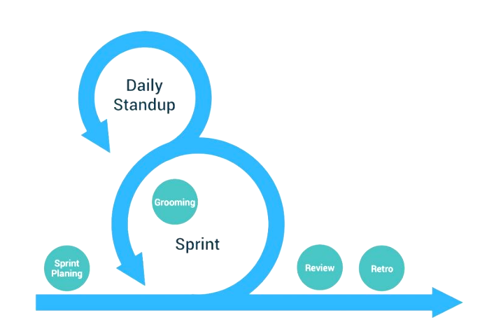
Wrap-up
Tools
Github
Miro
Whatsapp
R Studio
Excel
Power BI
Python
Agile Cerimonies
Planning
Dailies
Retrospective
Demo (Task 1)

Slide 19



Wrap-up
Tools
Github
Miro
Whatsapp
R Studio
Excel
Power BI
Python
Agile Cerimonies
Planning
Dailies
Retrospective
Demo (Task 1)
Projetc Issues
Understanding and defining the scope
Defining Dataset
Solution Issues
Data processing
Data amount was restricted for prediction
Running R Code in PowerBI

Slide 20

Empowering Your Decisions, Elevating Your Success
Q/A

Slide 21

Thank You ;)

